Slide 1
St Margaret’s School Spring Term 2025 Maths in Year One

Slide 2
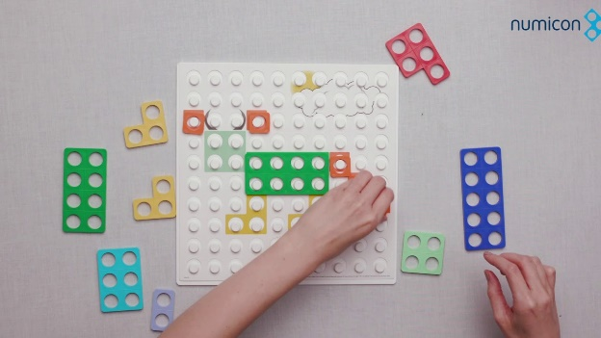
Content of Today’s Session
What does the curriculum look like?
What do we do in school?
Useful resources – Physical, books and websites
How you can help at home
Questions
Activity Time

Slide 3
The curriculum in school
White Rose scheme of learning:
“Adopting a White Rose Maths approach to teaching means making sure all children have the same opportunities to learn and the support they need to fully grasp concepts.” White Rose
Mastering Number (fluency)
Mastery, reasoning and problem solving

Slide 4
The National Curriculum
Number
Transition from EYFS.

Slide 5
The National Curriculum
Addition
&
Subtraction
Transition from EYFS.

Slide 6
The National Curriculum
Multiplication
&
Division
Transition from EYFS.

Slide 7
The National Curriculum
Fractions
Transition from EYFS.

Slide 8
The National Curriculum
Measurement
Transition from EYFS.

Slide 9
The National Curriculum
Measurement
Transition from EYFS.

Slide 10
The National Curriculum
Geometry
Transition from EYFS.

Slide 11
What does a maths lesson look like in Year One at St Margarets?

Slide 12
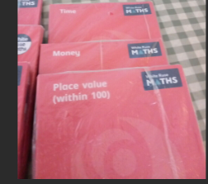
How do we teach maths?
In Year One:
We build on Reception. EYFS curriculum leads smoothly into Year One.
Hour maths session: Basic skills then main learning & 15 minutes fluency.
All of these encompass: My turn your turn, partner work and basic skills

Slide 13
What is maths?
I hour maths lesson
Starter & warm up
Modelling (I do)
We do
You do (workbooks)

Slide 14
+ Mind set!
Don’t pass on any personal negative experiences.
Mathematicians get stuck!
We don’t care if you make a mistake!

Slide 16
Focus on Fluency
Number bonds 1-10
Counting in 2’s 5’s 10’s
Efficient strategies- subitise? Count in 2’s? Spot the doubles?
How could we count these?
Some children may….
It's about making it explicit.
MASTERING NUMBER

Slide 17
Fluency
Mastering number
‘This project aims to secure firm foundations in the development of good number sense for all children from Reception through to Year 1 and Year 2. The aim over time is that children will leave KS1 with fluency in calculation and a confidence and flexibility with number. Attention will be given to key knowledge and understanding needed in Reception classes, and progression through KS1 to support success in the future.’

Slide 18
Mastery
Really important for children to explain their thinking.
Reasoning- dig deeper and push for more!
Shows whether children have a good understanding of basic concepts in order to move them forward in their learning.
We do this through partner work and ‘MTYT’
Make links explicit!

Slide 19
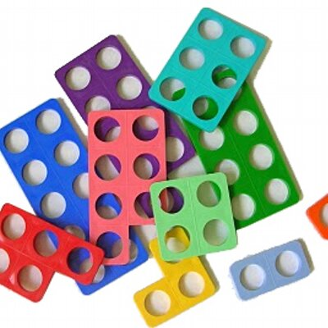
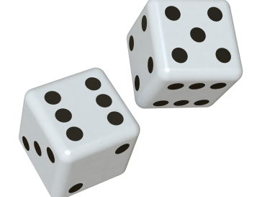
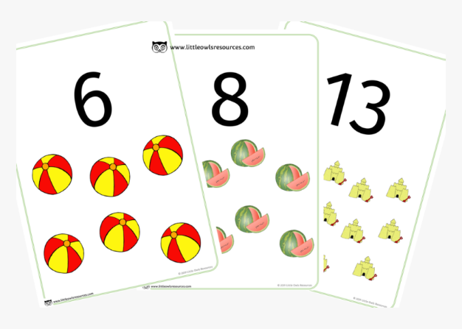
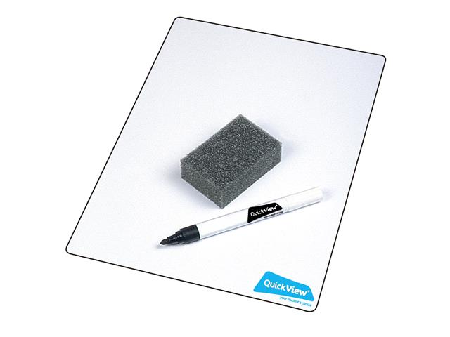
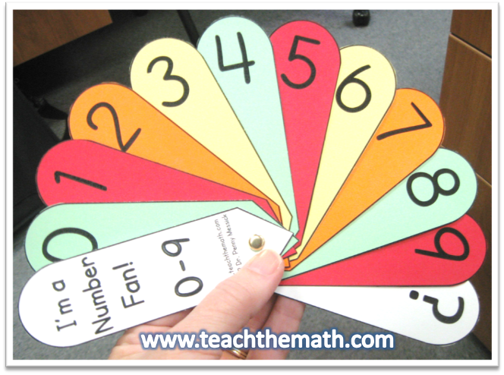
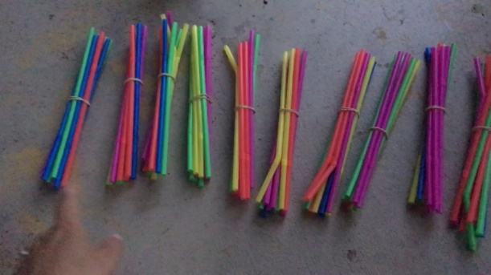
Physical resources

Slide 20
How do we support those that find it tricky?
Targeted support
We ask for your help!

Slide 21
How you can help at home
Number formation
Model number writing and reading in different ways: Lists, tracing, birthday cards, buses, front doors, recipes, in books, phones
Mathletics
White Rose home learning
Read the newsletters to see what we have been focusing on at school

Slide 22
Useful websites
https://login.mathletics.com/ Mathletics
https://www.topmarks.co.uk/maths-games/hit-the-button - Quick fire maths
https://www.topmarks.co.uk/learning-to-count/paint-the-squares
A great interactive tool to support counting in 1’s, 2’s, 5’s and 10’s
http://www.mathsphere.co.uk/resources/MathSphereSampleWorksheets.htm - Printable maths worksheets, free resources, fun and games.
http://www.crickweb.co.uk/ - Activities focusing on Maths and Literacy. Free to use
https://www.youtubekids.com/ You can search for a wide range of videos on number bonds, shapes, counting, phonics, Alphablocks, Number Jacks etc. ‘Art for Kids’ and ‘Cosmic Yoga Kids’.
https://whiterosemaths.com/homelearning?year=year-1
White Rose home learning
https://www.bbc.co.uk/iplayer/episode/m000t16h/numberblocks-series-5-your-turn
Numberblocks!

Slide 23
Home Learning

Slide 24
Questions? Thank you for coming! ☺

Slide 25
Activity Time ☺ 1. Counting accurately-efficient strategies How will you count the hedgehogs? 1’s 2’s 10’s? 2.Parts and wholes 3.Recognising numbers 4. Solving problems 5.Match the equation and the digit (answer) 6.Number bonds! Cups and cubes 7.Shape hunt.

