Slide 1
Maths in Year Four St Margaret’s C of E Primary Autumn Term 2024

Slide 2
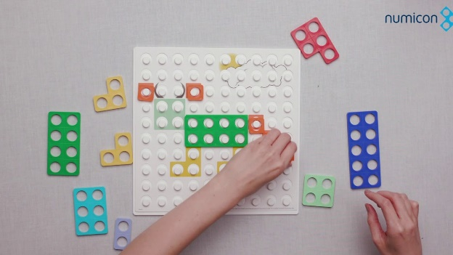
Content of Today’s Session
What do we do in school?
What does the curriculum look like?
Useful resources – Physical, books and websites
How you can help at home
Questions
Activity Time

Slide 3
What is Maths?

Slide 5
+ Mind set!
Careful with passing on personal negative experiences.
Mathematicians get stuck!
Create an environment to learn from mistakes!

Slide 6
The Maths Curriculum
White Rose scheme of learning:
“Adopting a White Rose Maths approach to teaching means making sure all children have the same opportunities to learn and the support they need to fully grasp concepts.” White Rose
Mastering Number (fluency)
Mastery, reasoning and problem solving
Books

Slide 7
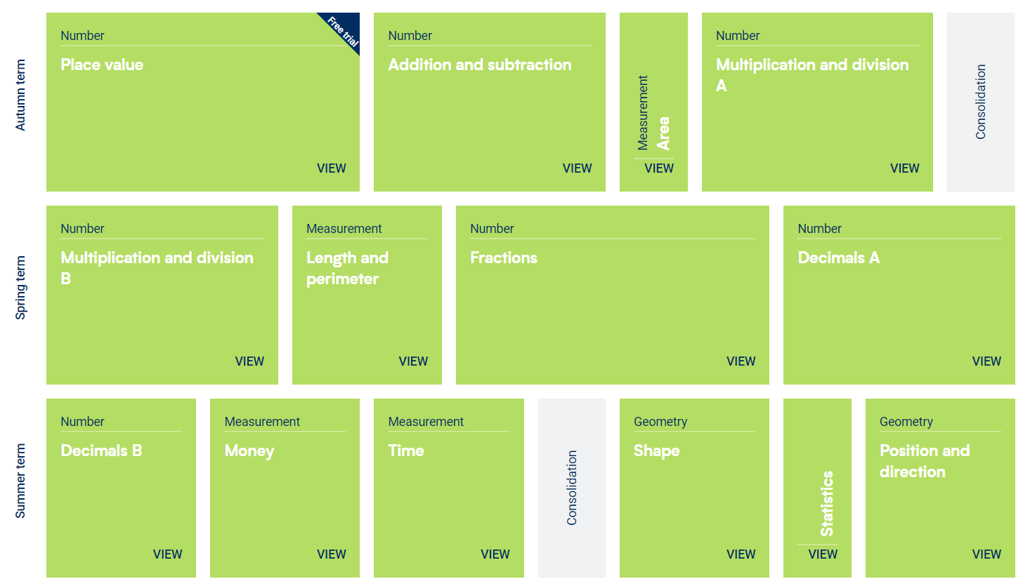
Maths in Year 4

Slide 8
The National Curriculum
Number

Slide 9
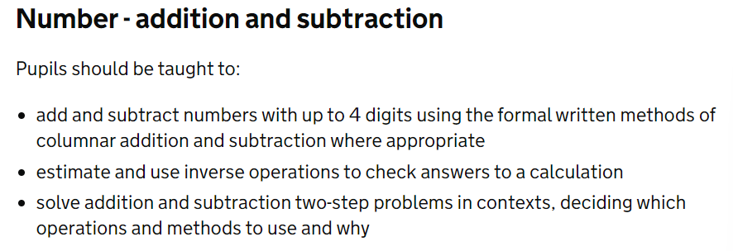
The National Curriculum
Addition
&
Subtraction

Slide 10
The National Curriculum
Multiplication
&
Division

Slide 11
The National Curriculum
Fractions

Slide 12
The National Curriculum
Measurement

Slide 13
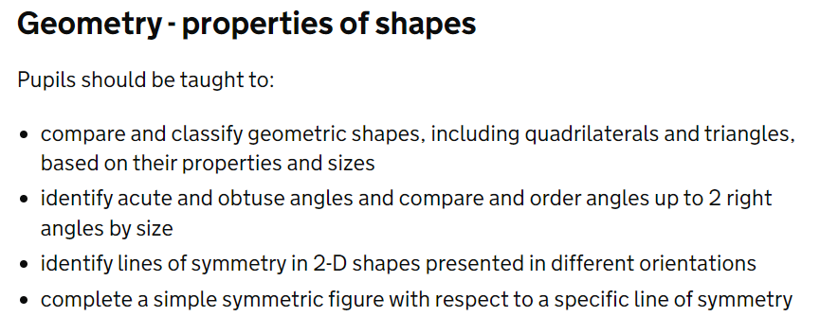
The National Curriculum
Geometry

Slide 14
The National Curriculum
Statistics

Slide 15
How do we teach Maths?
In Year Four:
Daily hour maths session: Fluency Recap and New Learning.
I DO: Explicit Teaching – Show the process
WE DO: Shared Models – Target children to work through misconceptions
YOU DO: Independent Practice – Assessment for Learning and Mastery

Slide 16
Focus on Fluency
Number bonds to 100
Times tables
Efficient strategies- subitise? Count on/back? Spot the doubles?
How could we count these?
Some children may….
Its about making it explicit.
MASTERING NUMBER

Slide 17
Fluency and Mastering Number
Mastering number
‘Mastering Number is a daily programme to develop pupils' fluency with an understanding of number to build firm foundations for future success in mathematics learning. In Years Four and Five, this project enables pupils to develop fluency in multiplication and division facts. This is an essential skill that children need to be able to access trickier Maths learning. Imagine having to tackle 76 x 45 and not knowing your times tables? How much harder does this become?’

Slide 18
Mastery
Really important for children to explain their thinking.
Reasoning- dig deeper and push for more!
Shows whether children have a good understanding of basic concepts in order to move them forward in their learning.
We do this through partner work and ‘MTYT’
Make links explicit!

Slide 19
How do we support those that find Maths difficult? . Lesson Structure – I, We, You . Targeted Questioning . Precision Teaching . Strong Partnerships . Physical Resources . Home Learning

Slide 20
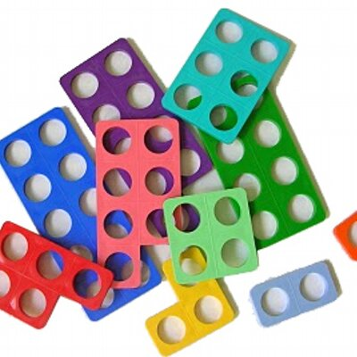
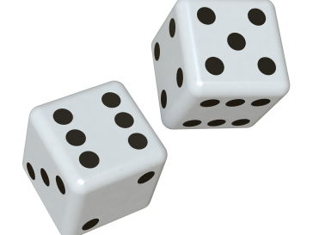
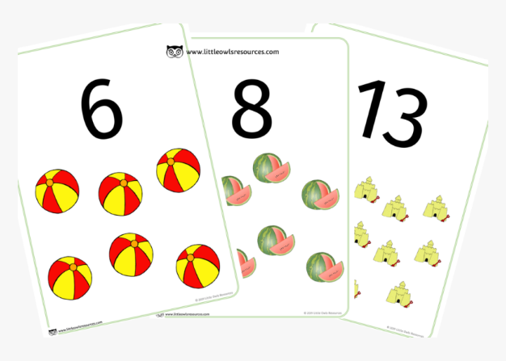
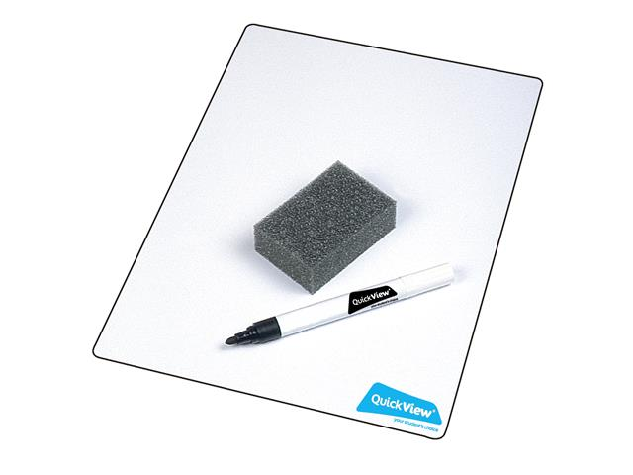
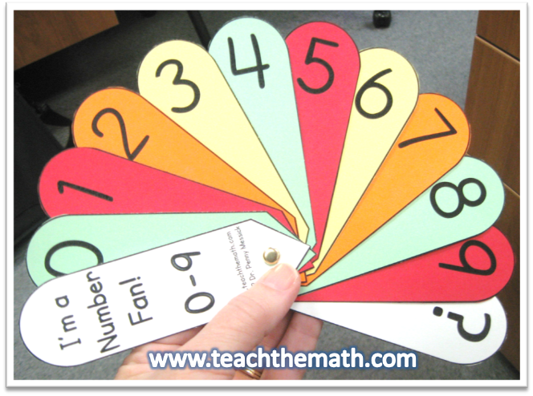
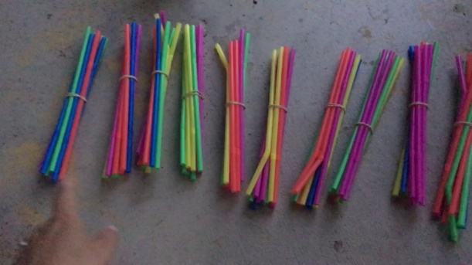
Physical resources

Slide 21
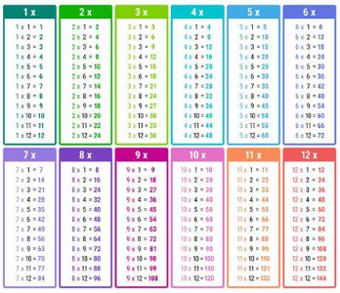
Your help at home
Model number writing and reading in different ways: Lists, tracing, birthday cards, buses, front doors, recipes, in books, phones
TTRS – Times Tables!
Mathletics - White Rose Linked
Read the newsletters to see what we have been focusing on at school

Slide 22
Useful websites
https://login.mathletics.com/ Mathletics
https://www.topmarks.co.uk/maths-games/hit-the-button - Quick fire maths
https://www.topmarks.co.uk/learning-to-count/paint-the-squares
A great interactive tool to support counting in 1’s, 2’s, 5’s and 10’s
http://www.mathsphere.co.uk/resources/MathSphereSampleWorksheets.htm - Printable maths worksheets, free resources, fun and games.
http://www.crickweb.co.uk/ - Activities focusing on Maths and Literacy. Free to use
https://www.youtubekids.com/
You can search for a wide range of videos on number bonds, shapes, counting, phonics, Alphablocks, Number Jacks https://whiterosemaths.com/homelearning?year=year-1
White Rose home learning
https://www.bbc.co.uk/iplayer/episode/m000t16h/numberblocks-series-5-your-turn
Numberblocks!

Slide 23
Any questions?

Slide 24
Activity Time 1. Add two 4-digit numbers with exchanges 2. Subtract two 4-digit numbers with exchanges 3. 3, 6 and 9 Times Tables 4. Creating Decimals using Place Value 5. Equivalent Fractions on a Number Line 6. Interpreting Charts 7. Making Shapes using Area 8. Perimeter of Polygons 9. Represent Numbers to 10,000 10. Multiply 3-digit by 1-digit numbers

