Slide 1
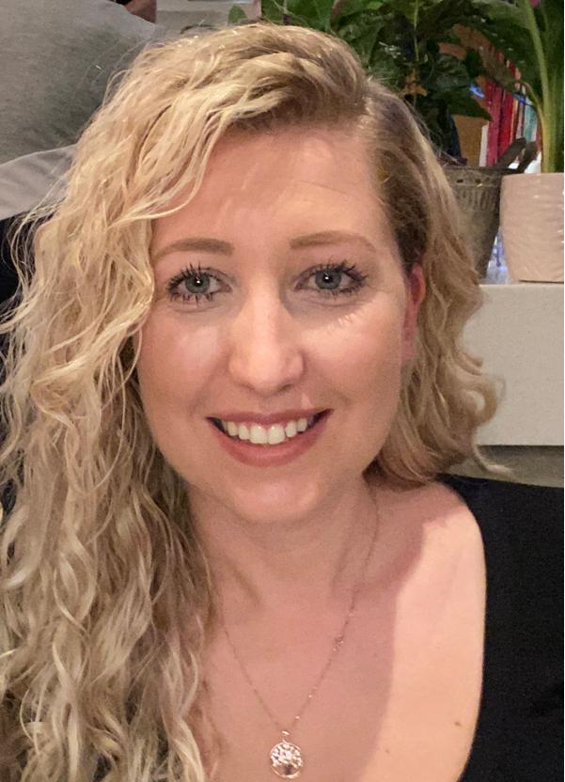
Meet the Teacher – Year 6
Mrs Tipton

Slide 2
Our Class
Support Staff:
Mrs Tomson: Monday, Tuesday Wednesday
Mrs Dziama: Wednesday, Thursday, Friday
Mrs Green: Monday, Wednesday, Thursday, Friday
Mrs Lightbourne- interventions, PPA cover on Tuesday afternoon and Friday all day.

Slide 3
Daily routines:
Maths and English to be taught in the mornings
All other subjects in the afternoons
PE days- Monday and Friday (children can wear PE kit to school)

Slide 4
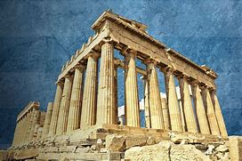
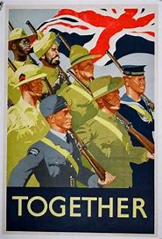
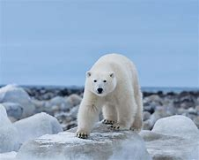
Topics this year:
World War 2 –Autumn Term
Frozen Kingdom (The Polar Regions)- Spring Term
Ancient Greece and the Geography of Greece- Summer Term
There will be a cross curricular approach where possible.

Slide 5
Moving into Year 6
More focus on independence and responsibility
Role Models- Children should be setting an example to the younger children in school
It’s okay to be challenged – moving into our stretch zones
Mistakes are okay as long as you try your best at all times!
Growth mind-set – persevere to achieve your goals.
We don’t always succeed in our 1st attempt- building resilience is key!

Slide 6
Reading
Home Reader (All of Year 6 will get the same book) discuss the book in depth – paying particular attention to:
new vocabulary
predicting what might happen next
summarising what they have read
making inferences based on the text
Class reader: These are high quality texts to be shared in class. This half term it will be ‘Goodnight Mr Tom’ relating to our WW2 topic.
Encourage a range of reading at home (magazines, newspapers, comics, recipes etc)

Slide 7
Home Learning
Home Reader with comprehension questions
Weekly spellings to be tested on a Friday (differentiated for children that need it)
Mathletics set online.
Reading for pleasure book (picked by your child)
*Some children will be sent home with a book from
our reading scheme. This is in addition to the home reader and
is given to increase your child’s reading fluency (please read this with them if they receive one).
As last year
NB daily breaktime snacks to be fruit/healthy apart from Friday please.

Slide 8
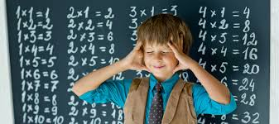
Times Tables
Times tables are the building blocks of your child’s Maths knowledge and need to be learnt and revised for easy recall.
Children have access to Times Table Rock Stars at home via their personalised log-ons.
Repetition, repetition, repetition is key!

Slide 9
Behaviour :
High expectations- be the best you can be!
Behaviour policy- see our school website for more information
Children who produce work that isn’t their best or make poor choices with their behaviours will miss minutes of their break time or be seen by Mrs Delaney or Mrs Thomas if the incident is more serious.
House points are given as rewards.
Celebration assembly on a Friday- 2 certificates to be earned
(One voted for by the class and one picked by myself for going above and beyond)

Slide 10
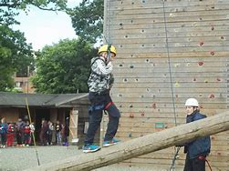
Special to Year 6
Additional responsibilities such as Head Boy/Girl, House Captains, Head of School Council
We will be leading the Remembrance Assembly in November
SATS week is week beginning May 12th 2025.
(more information to follow)
We will encourage children to do their best and try to make it as uneventful as possible. It is not something we will be constantly talking about; I firmly believe in good teaching, not teaching to the test and educating in a whole sense.
Please do not use any of the actual past papers as we use these for assessment purposes.
After SATs
Year 6 Residential Trip- during May after SAT’s (Wednesday until Friday)
(more information to follow)
Performance in the Summer Term and a Leavers Service in Church.

Slide 11
Contacting us
You can catch me at the end of the day
Email into the school office and I will get back to you within 72hours (as school policy states)
If you need specialist support with SEND please email Mrs Bannister through the school office as normal.
I may phone home on occasion as necessary

Slide 12
Any questions

