Slide 1

St Margaret’s School
Welcome to Year Three!

Slide 2


Mrs Chaplin & Ms Sandhu
Monday-Tuesday Wednesday- Friday
Mrs Govier – PPA cover on a Wednesday afternoon from 2.15
Mrs Bough – Learning Support Assistant

Slide 3
The children have settled in brilliantly!

Slide 4
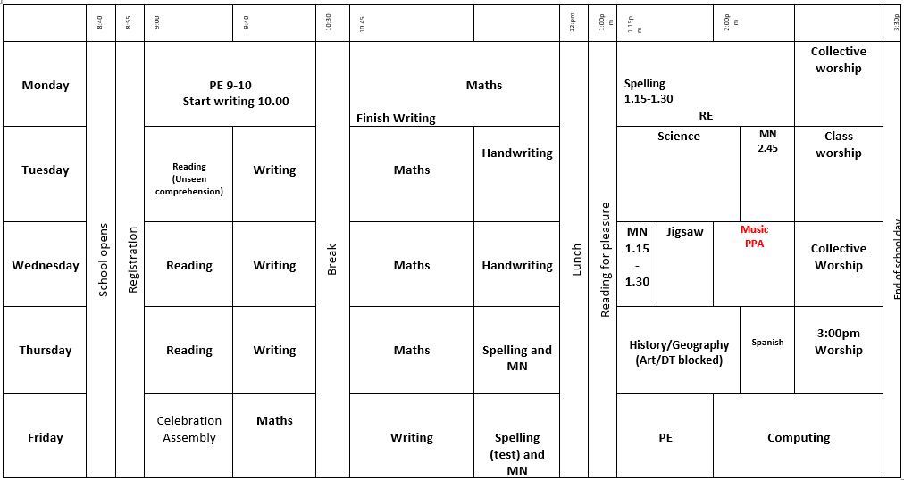
What the week looks like...

Slide 5
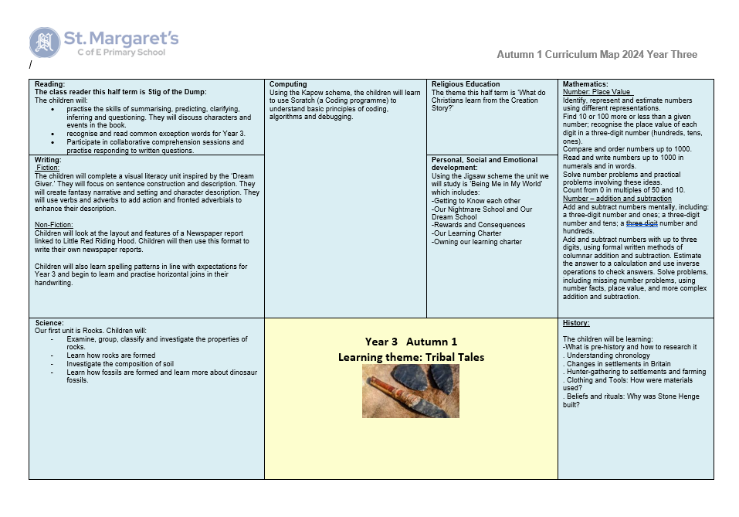
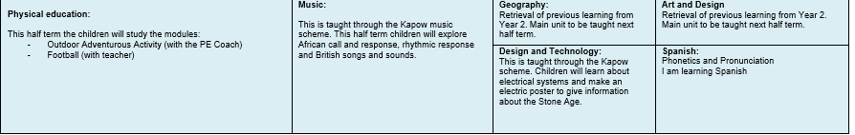

Slide 6
Our Humanities Topics....
Tribal Tales
Urban Pioneers
Egyptians
Scrumdiddlyumptious

Slide 7

Trips and Visits
Birmingham City Centre – Spring term linked to our Urban Pioneers topic.
Cadbury World – Summer Term linked to our Scrumdidliumptious topic
Gudwara – Place of worship R.E

Slide 8
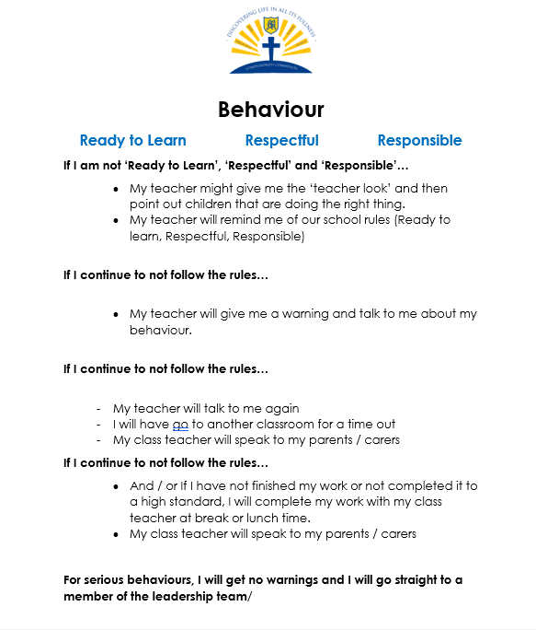
Behaviour Policy

Slide 9

Celebrating our behaviour!
House points
Star of the day
LOTS of praise!
Certificates

Slide 10
General reminders....
P.E Days Monday and Friday – pumps to be kept in school in case of wet weather. PE kit as stated on the policy please.
Reading book and diary in school each day in case an adult reads with them. Please sign when reading at home.
Home learning and reading books/diary to come in on a Wednesday and this will be sent home on a Friday
Stationary provided in school – no need to bring anything in unless specifically asked. Cloakroom space is tight!
Fruit snack Monday - Thursday

Slide 11
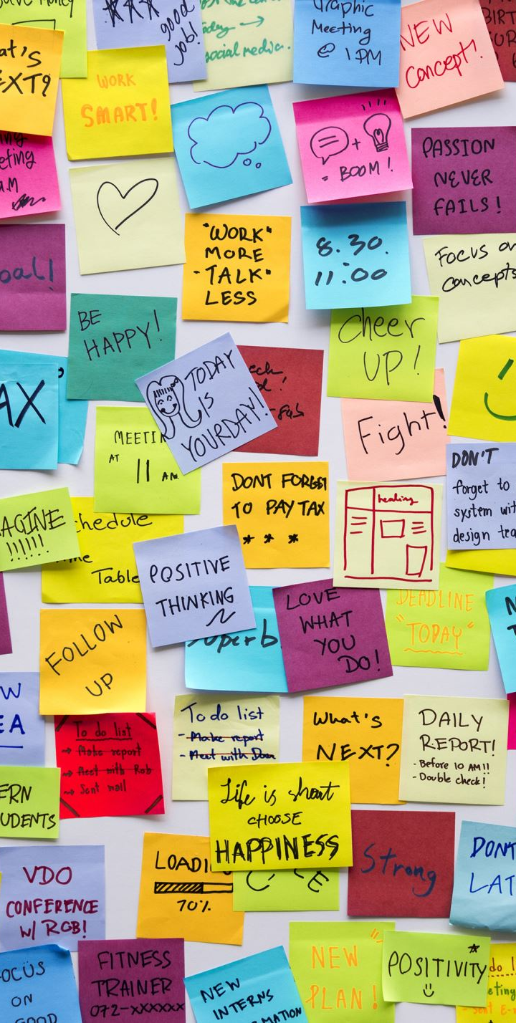
High expectations!
High expectations of the children at all times: work and behaviour
Responsible, Respectful and Ready to Learn.

Slide 12

Our School Values

Slide 13
Communication
We are always on hand to support you with any questions or queries. Please do grab us at the end of the day if you need to.
Please do tell us things we may need to know e.g. bad night's sleep etc.

Slide 14
How you can help at home (Please bear with us while we set up Home Learning!)
Home learning will be set on a Friday and should be returned on a Wednesday.
Spellings will be tested each Friday – we will test the spellings they have been practising all week and then introduce the new rule and new spellings for the following week.
Spellings will be set weekly and tested in school.
Children will bring home a levelled reading book each week – please listen to them read and sign diary at least 3 times a week.
A longer novel will be sent home each term as a 'home reader' to share together and then the children will be set comprehension questions each week on this. This gives you an opportunity to discuss a text in more depth with your child; vocabulary, predictions, summarising, inferring.
Mathletics
Multiplication – MTC Y4. Weekly times tables challenges in class with a focus on improvement, not comparing themselves to others. Children need to learn the division facts as well so that they can see the link to the multiplication.

Slide 15
Any questions?

