Slide 1
Year 2
Meet the teacher
September 2024

Slide 2
Staff
Miss Hussain
Mrs Smith (Mon/Fri full day)
Mrs Edwards – phonic interventions
Mrs Brown (Wednesday morning helper)
Mrs Ashton – Thursday (cover) pm

Slide 3
Learning Themes
Autumn 1 - Street Detectives – Olton (Geography)
Autumn 2 – Street Detectives – Kenya (Geography)
Spring 1 – Dinosaurs (History)
Spring 2 – Muck Mess and Mixtures (GMM) –
Summer - Towers, Tunnels and Turrets (History and Geography)

Slide 4
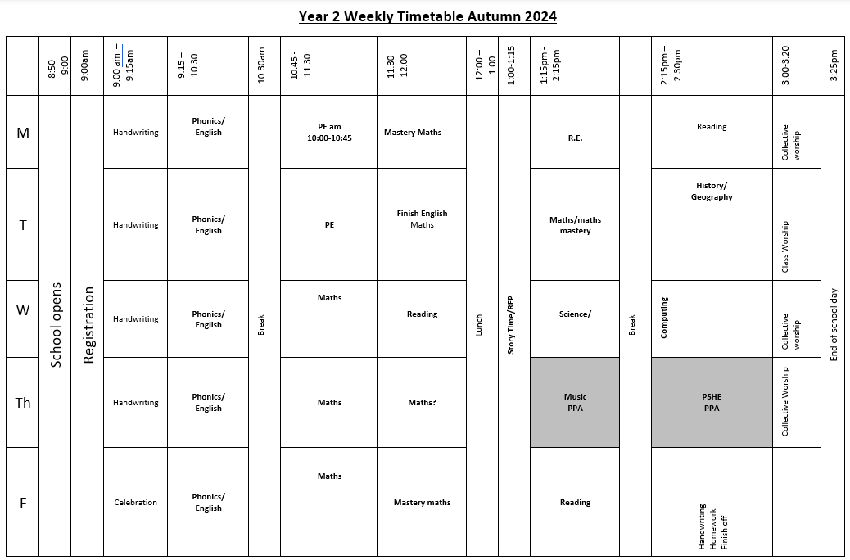

Slide 5
High Expectations
Behaviour policy change – house points/stickers – copy on website
Listening
Independence
Attitudes towards others
Attitude to learning
Uniform – including PE kit
Water Bottles
Respectful
Responsible
Ready to Learn

Slide 6
Home Learning – Friday 20th September
Home learning will be sent out each Friday
Mathletics activity
Termly Topic Projects – creative project
Spelling – 6 words which follow a rule plus 4 Common Exception Words each week
Reading – questions for class reader. Answers can be discussed or written.
Little Wandle/levelled readers will be assigned each week. Please record in Reading Journal. Please bring book bags in on Wednesdays
Mathletics and Times Table Rock Stars (x2, x5, x10)

Slide 7
SATs
Academy choice:
Children will be sitting ‘SATS’ at the end of the year – not traditional style
Phonics screening check for children who did not pass

Slide 8
Growth Mindset
Focus on personal best

Slide 9
Year 1 to Year 2… and the gap
WTS = your child is working towards the expected standard for their age.
EXP = your child is working at the expected standard for their age.
GDS = your child is working above the expected standard for their age.

Slide 10
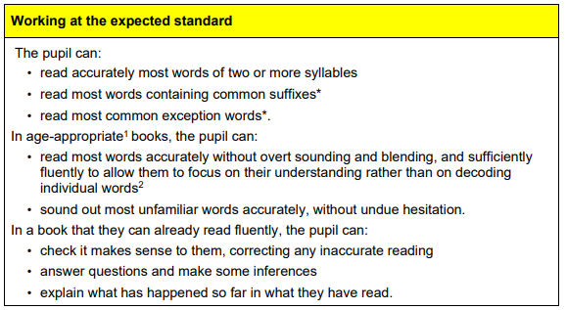
READING

Slide 11
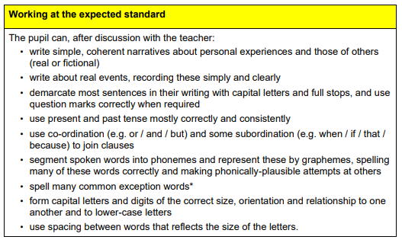
WRITING

Slide 12
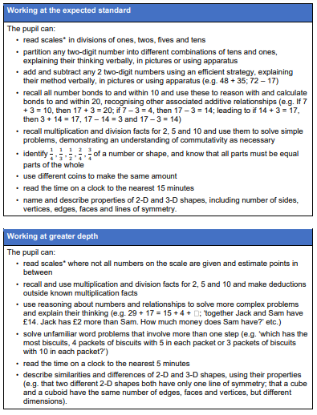
MATHS

Slide 13
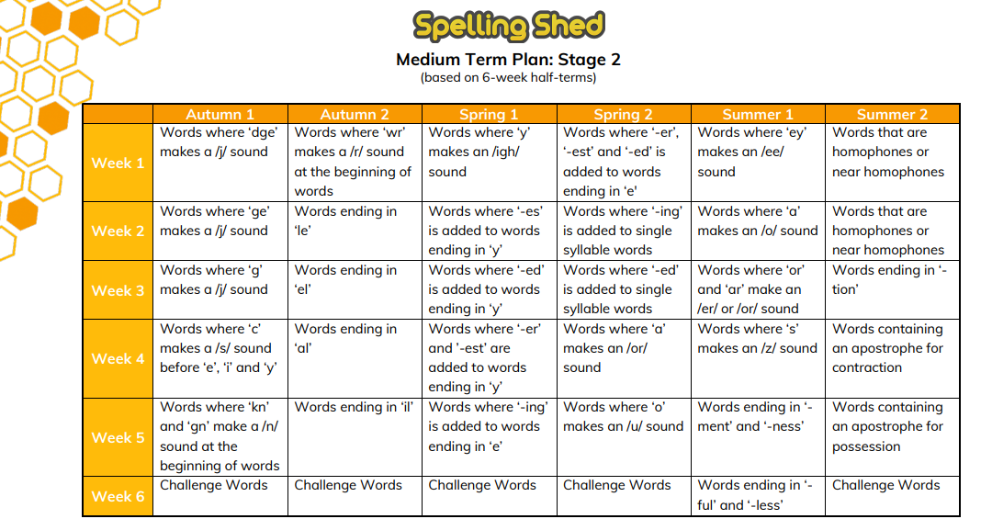
Spelling
Focus on spelling rules
3 sessions
Teach
Apply
Consolidate
Test on Wednesdays
Rapid Catch Up phonics intervention for children who did not pass Year 1 Screening Check

Slide 14
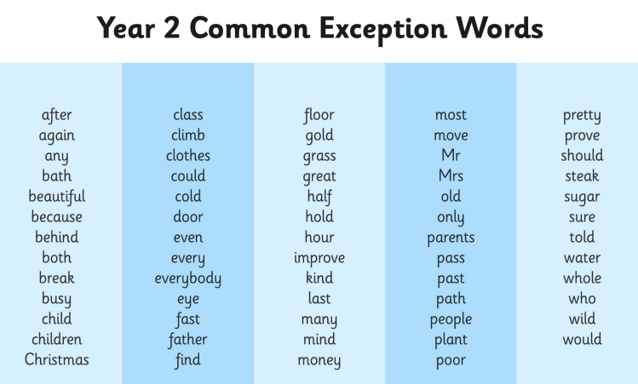

Slide 15
Reading! Please Read
Fluency, decoding and comprehension
Phonics sessions include reading as well as writing.
Whole class reading sessions
Focus on vocabulary and key skills
All children benefit from group discussion
Story time – Reading for pleasure – everyday after lunch
Homework reading
Class book - Read with an adult, discussion, discuss set questions and complete work
banded book
Reading for Pleasure at home – books, websites, fact finding, recipes, instructions, comics…..
(This can be recorded in your reading journal too)

Slide 16
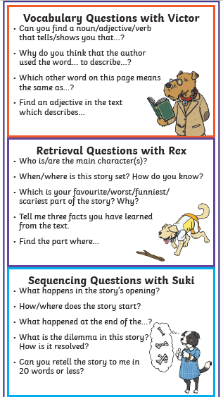
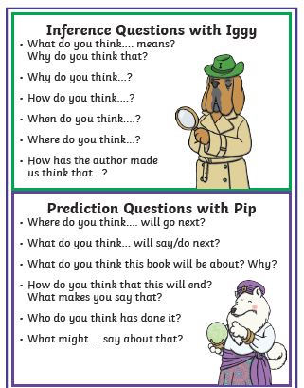
5 Key Skills…

Slide 17
Uniform
Plain navy blue tracksuit, school t-shirt with school logo only
Pumps will be kept in school
No earrings – wear a plaster/ no nail polish
No extra things bought in – sunglasses/ jewellery. Things get broken and children get upset

Slide 18
P.E.
Monday – Sports Coach
Tuesday– Miss Hussain
Full P.E. kit should be worn to school on Mondays and Tuesdays

Slide 19
Trips
Autumn – Explore around Olton
Spring – Islam Visitor
Summer (June/July) – Warwick Castle

Slide 20
Online Safety
It’s easy to think it doesn’t apply to children of this age…but it does.
Know what your child is playing and accessing
Check settings e.g. is location visible?
Can they communicate with others through the games? Be aware.
Your full name
Age
Passwords
Physical address
Your plans

Slide 21
End of the day
Thank you for being patient!

Slide 22
Communication
Email me via the office and I will get back to you.
I’m also happy to chat at the end of the day – once all children have been collected.

