Slide 1
St Margaret’s School Welcome to Year One!

Slide 2
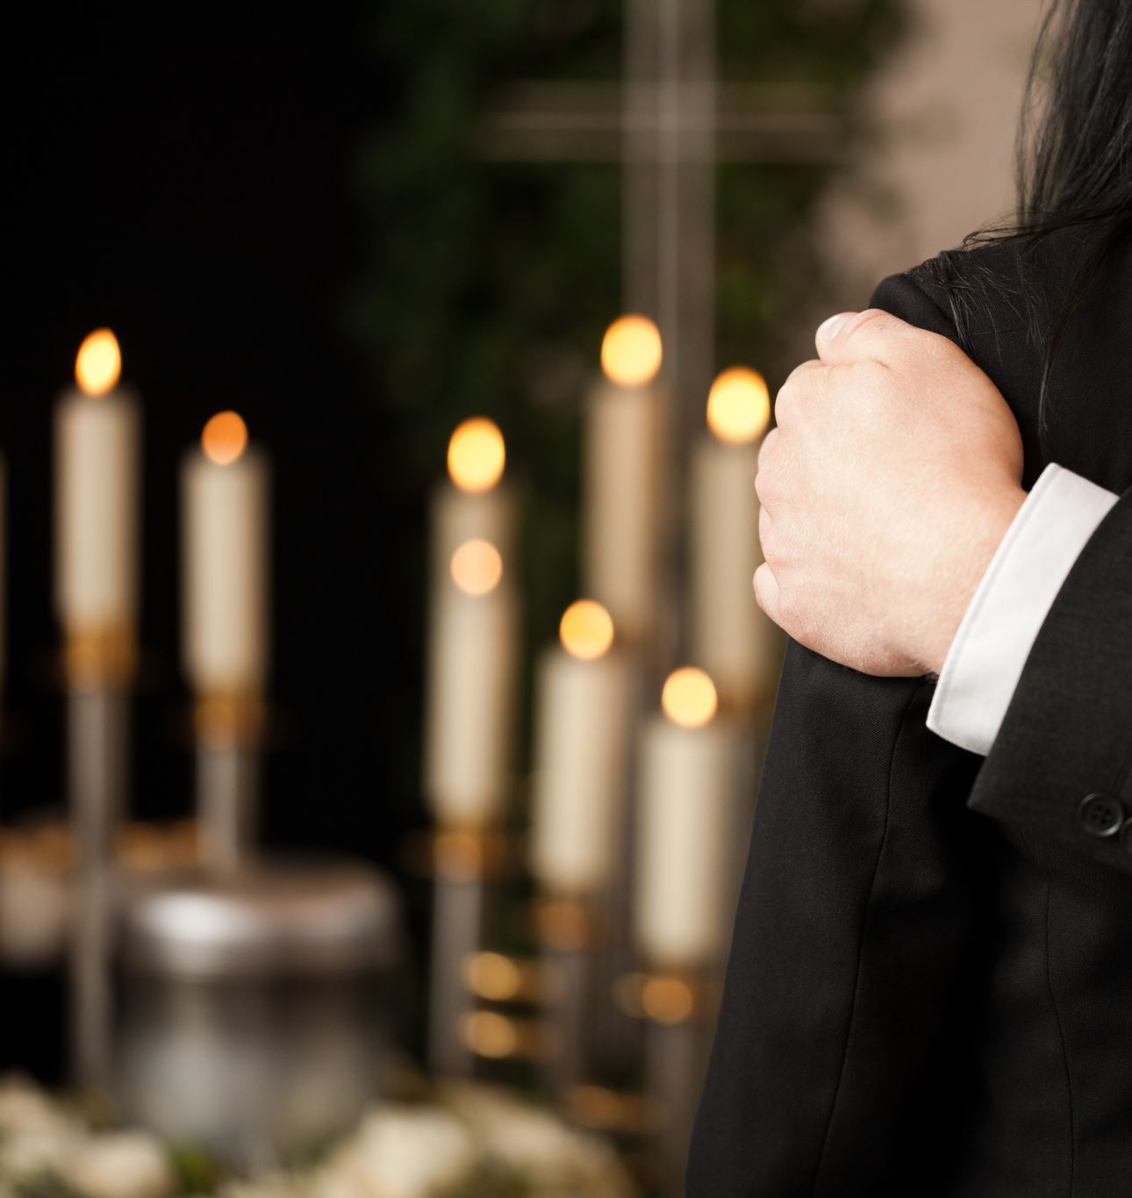
Mrs Crawford Monday- Wednesday & Mrs Thomas Thursday-Friday

Slide 3
We are lucky to have...
Mrs Fiteih
Mrs Cridland
Mrs Edwards

Slide 4
The children have settled in brilliantly! They are a credit to you!

Slide 5
​
Transition into Year 1
Mornings - Daily phonics lessons/Reading in a group/Maths activity/English activity/Handwriting alongside other activities.​
Afternoons – R.E/History/ Geography/Art and DT/Science/Music/P.E/Jigsaw (PSHE)​
Children in Year 1 will continue with a play based approach to learning for the initial part of the Autumn Term.​Gradual phase into formal learning.​
There will be a focus on emotional development and ensuring children can express themselves and understand their emotions and how to deal with them.

Slide 6
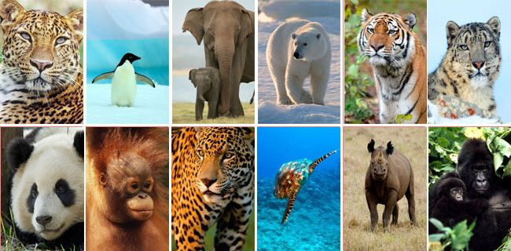
Our Autumn Learning
Group Title
Group A
Group B
Group C
Group D
Paws, claws and whiskers.
We will read the ‘Mixed up Chameleon,’
And study non-fiction texts on nocturnal animals.

Slide 7
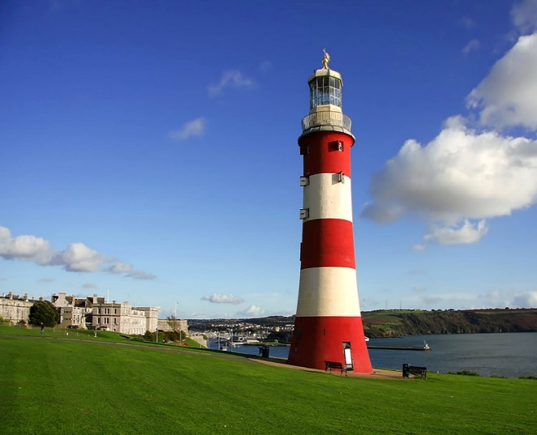
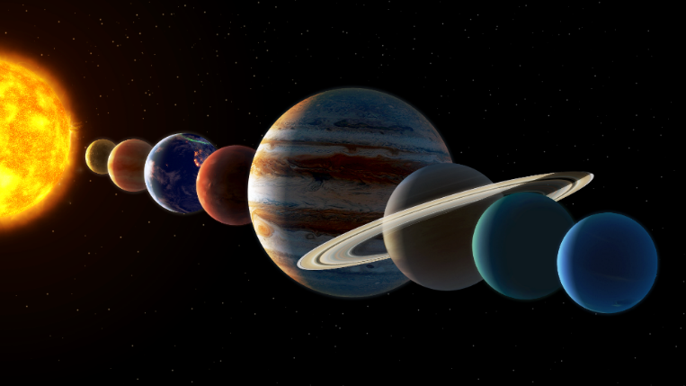
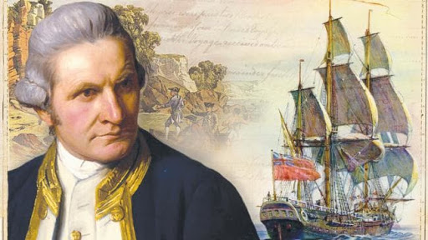
Spring Learning
Moon Zoom
Land Ahoy!

Slide 8
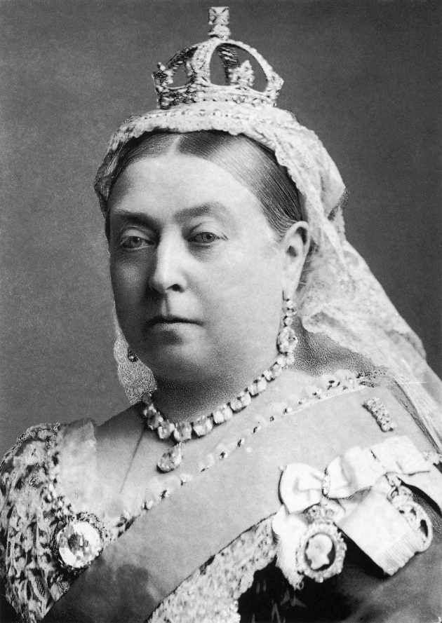
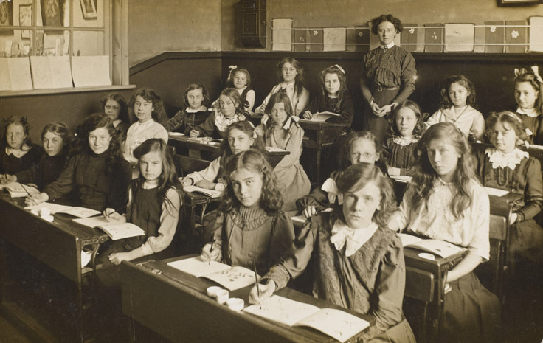
Summer
Memory Box

Slide 9
You may have heard of…
No hands up
Talk partners
Wriggle your jiggles

Slide 10
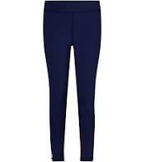
PE
PE kit to be worn on a Monday and
Friday.
Monday morning will be with a
Sports coach.
Navy jogging bottoms or leggings, white school
top and navy jumper. Pumps to stay in school.

Slide 11
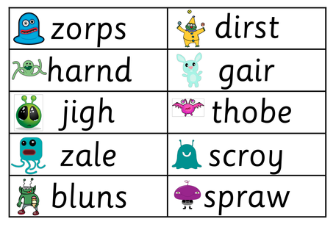
Phonics – Little Wandle
Daily phonics sessions
Weekly reading sessions (each group 3 times a week). This is the book that is then assigned for home learning.
Phonics screening check in June 2025
Recognition of sounds in words

Slide 12
More information
We have a Phonics workshop on Tuesday 1st October at 9.30 - 10.30

Slide 13
Behaviour Policy

Slide 14
Celebrating our behaviour!
House points
Stickers
Star of the day
LOTS of praise!
Certificates

Slide 15
General reminders....
P.E Days Monday and Friday – pumps to be kept in school in case of wet weather. PE kit as stated on the policy please.
Please bring your reading book and diary in school every Wednesday. Please sign when reading at home. Homework and reading books will come back on Fridays.

Slide 16
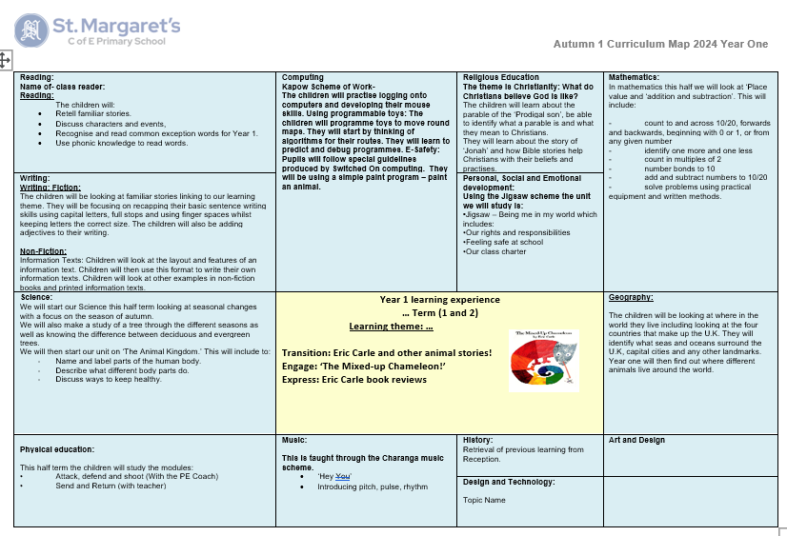
Year 1 Curriculum map- please see updated version on our website

Slide 17
High expectations!
High expectations of the children at all times: work and behaviour
Responsible, Respectful and Ready to Learn.

Slide 18
Our School Values

Slide 19
Communication
We are always on hand to support you with any questions or queries.
Please do email or make an appointment with either of us.
Please do tell us things we may need to know e.g. bad night's sleep etc

Slide 20
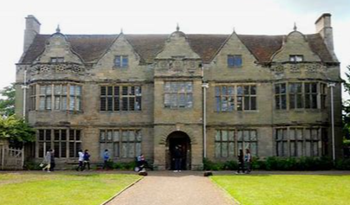
Trips and Visits
Animal man
Christmas Theatre Trip
St Johns Museum

Slide 21
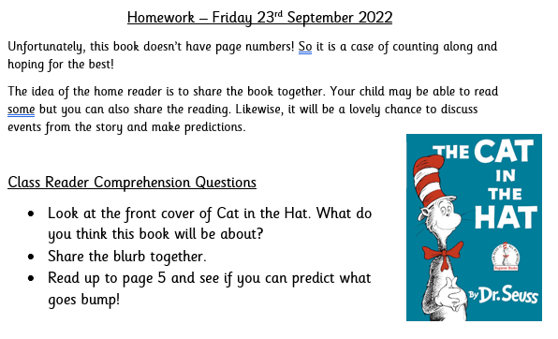
Home learning
Book bags – to be brought in on Wednesday and they will be sent home on Friday

Slide 22
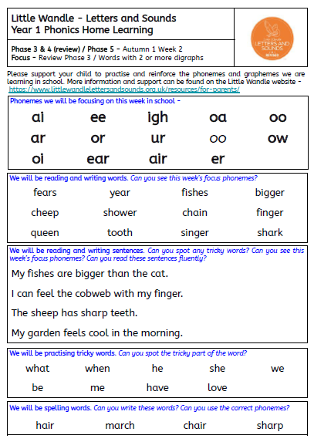

Slide 23
Home readers

Slide 24
Reading for Pleasure

Slide 25
How you can help at home (Please bear with us!)
Home learning will be set on a Friday and should be returned on a Wednesday.
Children will bring home a levelled reading book each week – please listen to them read and sign diary at least 3 times a week.
A story book will be sent home each half term as a 'home reader' to share together.
Mathletics

